Slide 1
Insights on the Profitability of Movies from the Year 1920 to 2020 Presentation by Rose Kyalo

Slide 2
Agenda
Introduction
Objective questions
Profitability
Profitability Evolution
Production budget vs profit
Key Findings
Recommendations
Conclusion

Slide 3
Introduction
Our goal is to help company X identify the types of movies currently thriving and suitable for production in their studio.
In this analysis, we will explore "The Numbers Movie Budget" dataset from The Numbers website.

Slide 4
Objective Questions
What types of movies are performing exceptionally well in terms of profitability?
How has the profitability of movie production evolved from the year 1920 to 2020?
Does the production budget significantly influence overall movie profit?

Slide 5
Profitability
Tool: Line graph
Data period: 1920 - 2020
Visualization goal : Worldwide Profit
5 top movies in positive worldwide profits

Slide 6
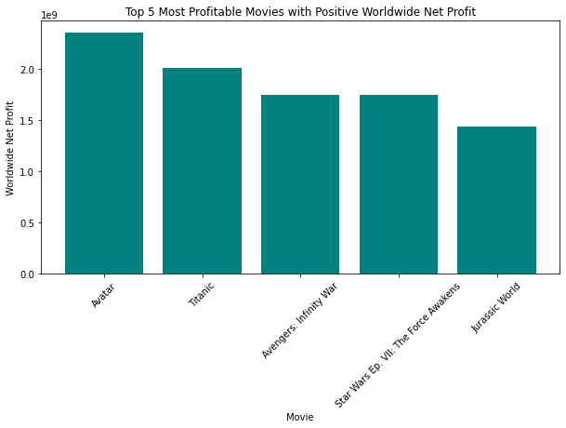
Project analysis slide 10
Profitability
Avatar , Titanic , Avengers: Infinity War , Star Wars Ep. VII: The Force Awakens , Jurassic World are top five movies that made a positive profit worldwide.
Our strategy on production of movies should focus on movies that have a global appeal.

Slide 7
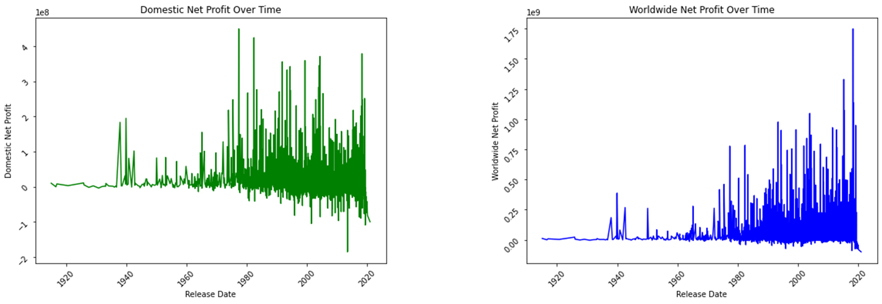
Visualization : Profitability Evolution

Slide 8
Production budget vs profit
Tools : Scatter plots
Data : Production budget versus the profit
Data Period : 1920 - 2020

Slide 9
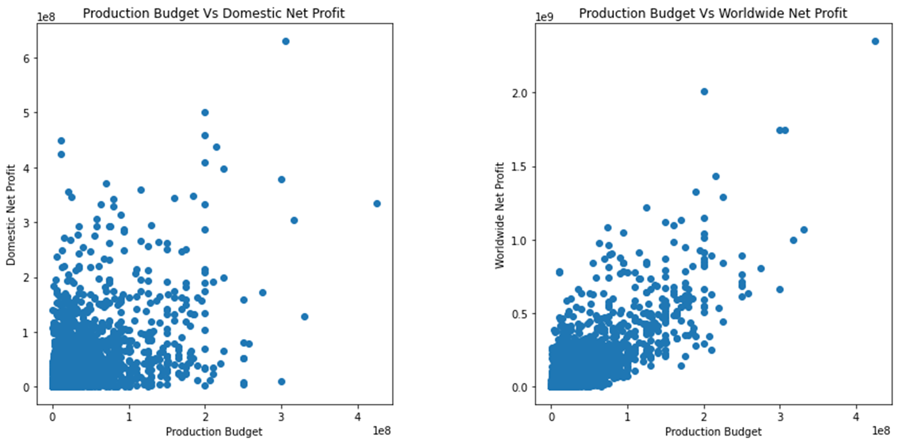
Visualization: Production budget vs profit

Slide 10
Key Findings
Prioritize movies with global appeal for higher profitability.
Learn from successful movies like Avatar, Titanic, Avengers: Infinity War, Star Wars Ep. VII: The Force Awakens, and Jurassic World.
Emulate movies that achieved profitability both domestically and worldwide, such as Titanic, Jurassic World, and Star Wars Ep . VII: The Force Awakens.

Slide 11
Recommendations
Focus on creating internationally appealing films.
Conduct market analysis to identify audience preferences.
Consider collaborations with experienced production houses.
Potential for Success:
Movie industry has consistent growth since 1920.
Embrace innovation and adapt to changing preferences.
Thrive in the dynamic and competitive movie industry.

Slide 12
Conclusion
Global appeal, learning from successful movies, and strategic budget allocation are key to success.
Company X is poised for success in the dynamic movie industry.
Commitment to quality storytelling and audience engagement is vital.
Thank you for your attention, and let's embark on this exciting journey together.

Slide 13
Thank You

